Slide 1

Video Game Workshop

Slide 2
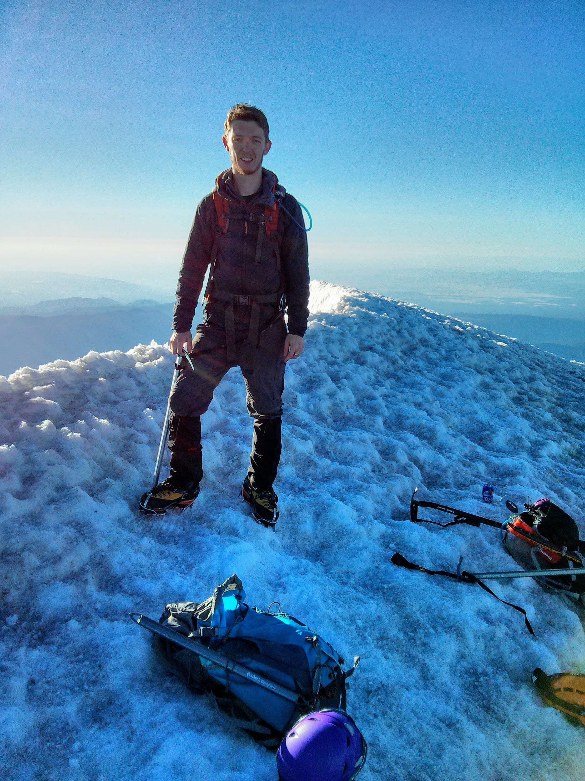
Who are you?
Nick
PhD student in Computer Science
Grew up in Albany, OR
Mountaineer and marathon runner
Married to a food scientist
Self-described nerd
Favorite media: Twitter

Slide 3
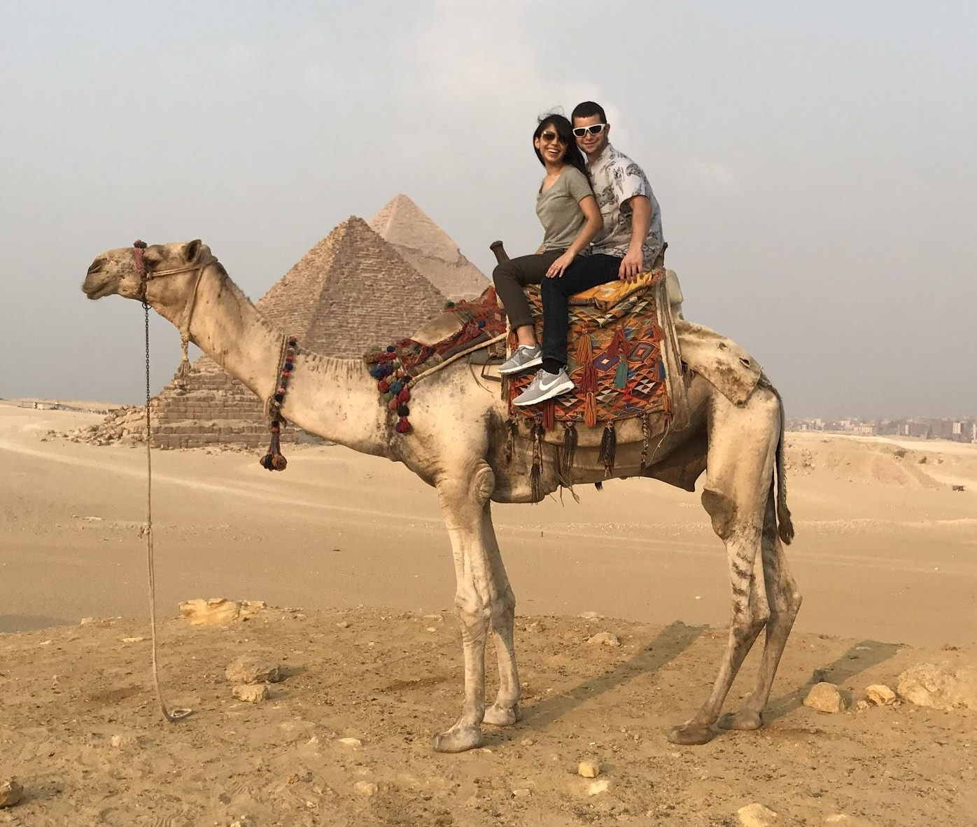


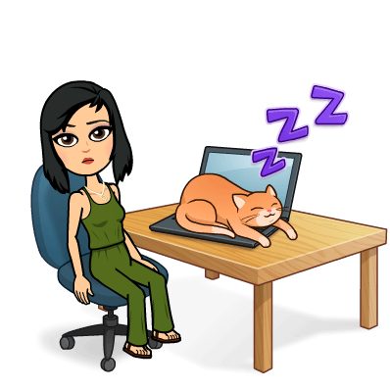
Who are you?
Claudia
Starting my master’s in the fall!
I'm a User Experience designer!
Got married last month!
I love to travel,
I recently traveled to Egypt!
Favorite media: Snapchat

Slide 4

Who are you?
Bryony
BS, MS, & PhD in Mechanical Engineering
Professor @ Oregon State
Studies applied artificial intelligence
Loves singing, her cats, and Sci Fi

Slide 5
Who are you?
Caity
I like playing outdoors!
Moving to Denmark in 12 weeks!
PhD student in Mechanical Engineering
Favorite media: Pinterest

Slide 6
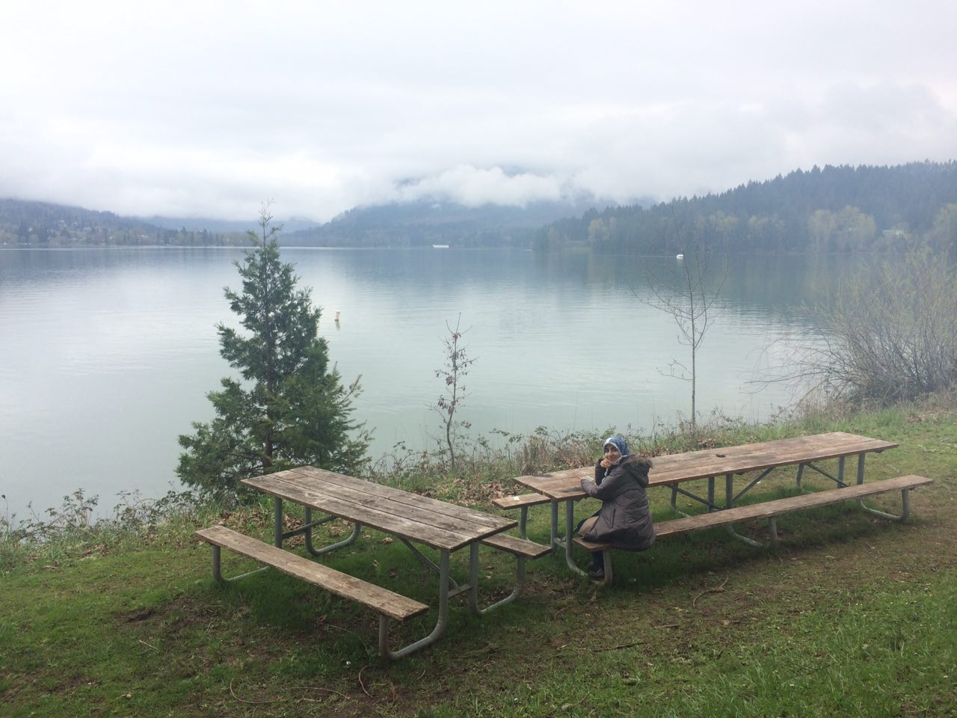
Who are you?
Mahsa
PhD student in Computer Science
Love travelling and photography
Born in Iran
Like Instagram to share amazing photographs

Slide 7
Hello!
Welcome to the 2017 ChickTech Video Game Workshop
Who are you? What makes you unique?
Are you more artsy or techy?

Slide 8
Pre-survey
http://sgiz.mobi/s3/Chick-Tech-HS-Pre-Survey

Slide 9
What are we doing today?
Learning to use Stencyl & Piskel
Understand a little bit of coding
Designing your own game
Creating your game
Having fun!

Slide 10
What is the morning schedule?
1. Teams
Form teams. Artsy and techy are good pairings.
2. Crash Course
Learn to use Stencyl for basic game development.
3. Demos
Explore some of the different possibility for Stencyl games.
4. Leader Demos
Leaders will demonstrate a few game variations that we created.
5. Game Pitches
Teams will decide on the type of game they want to make. Brief 1-2 sentence pitches.
6. Lunch
Refuel for the afternoon!

Slide 11
Crash Course
Learning to use Stencyl

Slide 12
Demos
Best Stencyl games online
Link

Slide 13
Leader Demos
Side Scroller & Top Down games

Slide 14
Game Pitches
1. Decide on the type of game you want to make.
2. As a team, give a brief 1-2 sentence pitch.

Slide 15
Lunch Time
Workshop resumes at 1:00pm

Slide 16
Open Work Time
Work on creating your game.
Workshop wrap-up at 4:30pm.

Slide 17
Post Survey
http://sgiz.mobi/s3/Chick-Tech-High-School-Workshop-Survey

